Slide 1

PyClimaExplorer
Turning Climate Data into Actionable Insights
~ Team Avengers
Hack It Out – Technex'26

Slide 2

The Challenge
Climate Data is Complex
Researchers and the public struggle to interpret raw climate datasets from NetCDF files. Temperature, precipitation, and wind speed data remain locked in technical formats.
Current Tools Fall Short
Existing platforms require technical expertise and lack interactive features. Without intuitive visualization, critical climate trends remain invisible to decision-makers.

Slide 3
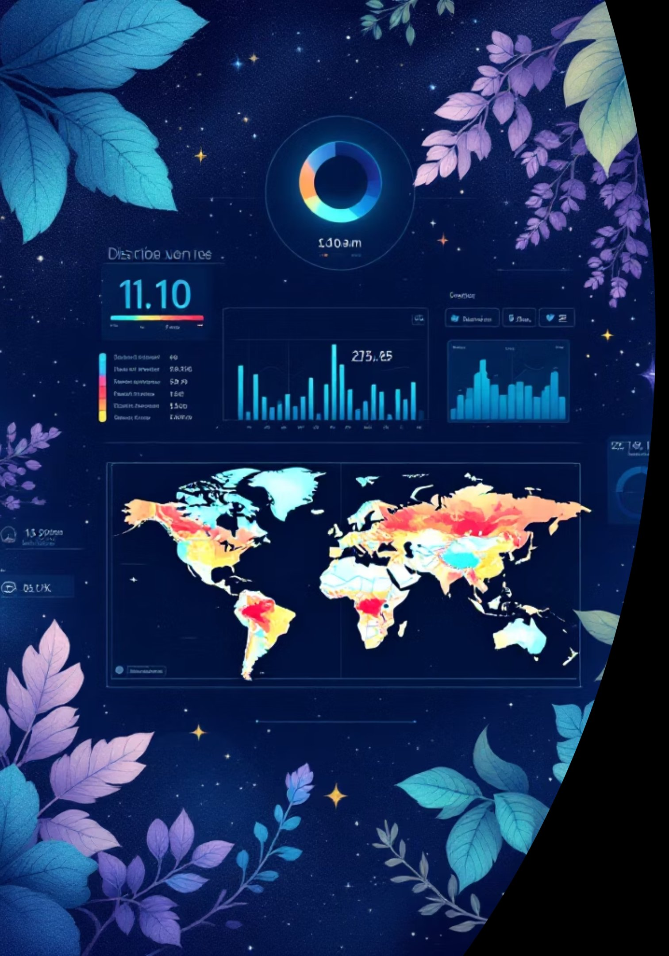




Our Solution
Interactive Global Heatmap
Time-Series Trends
Visualize temperature, precipitation, and wind patterns across the entire planet with dynamic color coding
Track climate variables at specific locations over decades with interactive line graphs
AI-Powered Insights
Generate automated analysis and detect patterns in climate data instantly

Slide 4

Powerful Features
Global Climate Heatmap
Location-Based Time-Series
AI-Generated Insights
Dynamic visualization of temperature, precipitation, and wind speed across all continents with real-time data rendering
Machine learning algorithms identify anomalies, trends, and correlations automatically
Analyze climate trends at any coordinate point with historical data spanning decades
Climate Comparison Mode
Future Predictions
Side-by-side analysis of different time periods (e.g., 1990 vs 2020) to visualize climate change progression
Project climate variables forward using trained machine learning models

Slide 5
Technology Stack
Frontend
HTML, CSS, Vanilla JavaScript
Backend
Python with Flask/FastAPI
Creates the interactive user interface for the
climate dashboard.
Handles API requests and processes climate data.
Data Processing
Pandas and NumPy
Machine Learning
Scikit-learn
Used for cleaning, transforming, and analyzing climate datasets.
Implements prediction models for climate trend analysis.
Visualization
Plotly.js /Chart.js
Dataset
Global Climate Dataset
Generates interactive charts like temperature trends
and precipitation graphs.
Includes temperature, precipitation, wind speed, humidity,
latitude, longitude, and time date.

Slide 6
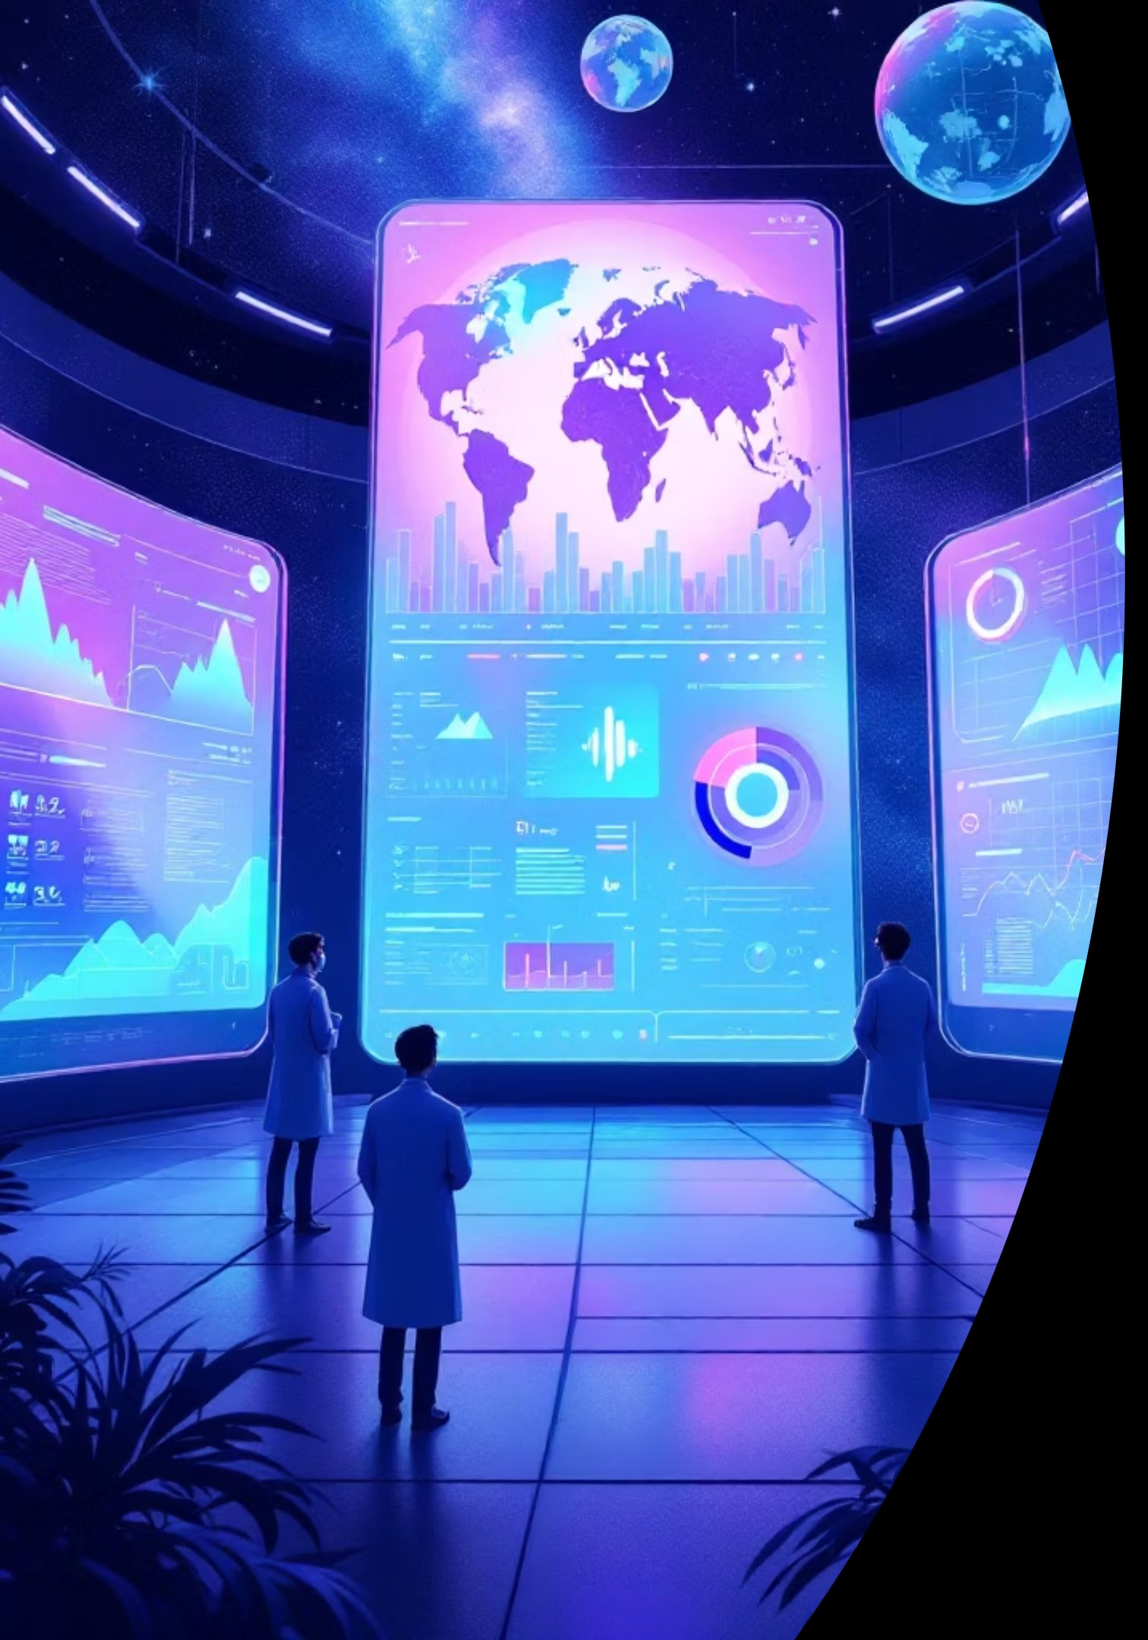



Impact & Future Vision
Accelerate Research
Researchers explore climate datasets in minutes instead of hours
Public Understanding
Makes climate trends accessible to non-technical audiences
Data-Driven Decisions
Empowers policymakers with actionable climate insights
Future Enhancements
3D globe visualization with WebGL rendering
Real-time satellite data integration
AI-driven climate risk prediction for cities
Mobile application for field researchers

Slide 7

Thank You
We appreciate your time and interest PyClimaExplorer. Together, let's turn data into a brighter, more sustainable future.

